Slide 1

Decryption Outsourcing for Functional Encryption Using Blockchain - Pay as you decrypt
TEAM DETAILS
Sireesha Dasari (20EG105251)
Gorre Pavan (20EG105215)
Gudipati Saketh Kasyap (20EG105223)
Project Supervisor
Name: Mrs. K. Jyothi
Designation: Assistant Professor

Slide 2
Introduction
The project deals with pay as you decrypt mechanism.
Constructing a framework to solve the limitation caused by public-key encryption by considering the functional encryption (FE) as an encryption mechanism to protect data security and privacy in many emerging applications such as the cloud computing services.
Applications:
1) Data storage and file storage
2) Data sharing over the cloud

Slide 3
Problem Statement
Addressing the inefficiency of functional encryption (FE) schemes, often stemming from costly computations, the common approach of outsourcing to third parties lacks a standardized payment procedure.
This gap in functional encryption with outsourced decryption (FEOD) schemes, where neither party is inherently trusted, poses a challenge.
Finding a way to fill this void by proposing functional encryption with payable outsourced decryption (FEPOD) schemes.

Slide 4
Problem Illustration
Alice (User): Wants to securely store and share encrypted data using functional encryption.
Bob (Decryption Service Provider): Provides outsourced decryption services for functional encryption. Alice wants to compensate Bob for his decryption services but cannot fully trust him.
Blockchain System: Used to facilitate secure and transparent transactions between Alice and Bob.

Slide 5
Proposed Method
We focus on designing and implementing a concrete Functional encryption with payable outsourced decryption (FEPOD) schemes in a generic way, where the payment can be accomplished via a blockchain-based cryptocurrency and a platform to evaluate its feasibility and practicality.
An FEPOD scheme should enable efficient and public verification for the outcome of the outsourced decryption task. In other words, in an FEPOD scheme, anybody should be able to efficiently verify the correctness of the result solely based on the given public information.

Slide 6
Proposed Method
We propose a notion which allows anybody to check the correctness of the answer for the outsourcing computation task provided by an untrusted third party such that the payment can be processed by a blockchain-based cryptocurrency.
We describe the security model of an FEPOD scheme, present a generic construction of it, and analyze its security.

Slide 7
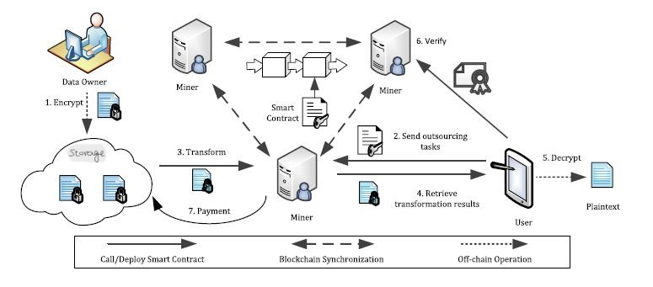
Proposed method illustration
Encrypt
Send outsourcing tasks
Transform
Retrieve transformation results
Decrypt
Verify
Payment

Slide 8
Experiment environment
SYSTEM REQUIREMENTS:
HARDWARE REQUIREMENTS:
Processor : i3 onwards
Hard Disk : 40 GB and above
Ram : 2 GB and above
SOFTWARE REQUIREMENTS:
Operating system : Windows 10 and above
Coding Language : JAVA
Data Base : MYSQL (SQLyog enterprise)
IDE : Netbeans 8.1
Server : Glassfish

Slide 9
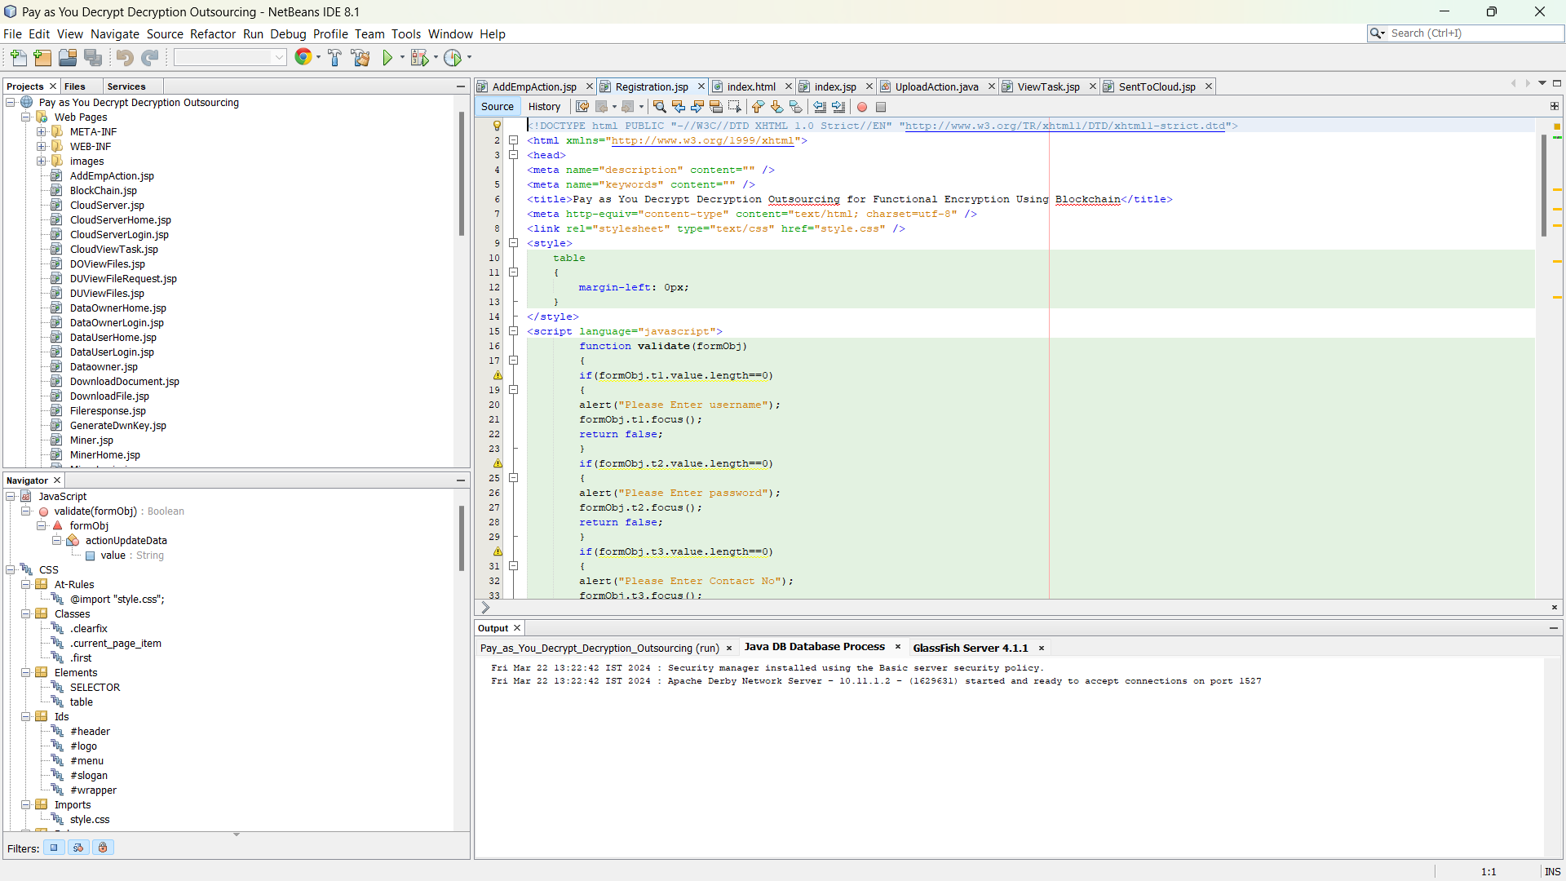
Experiment screenshots

Slide 10
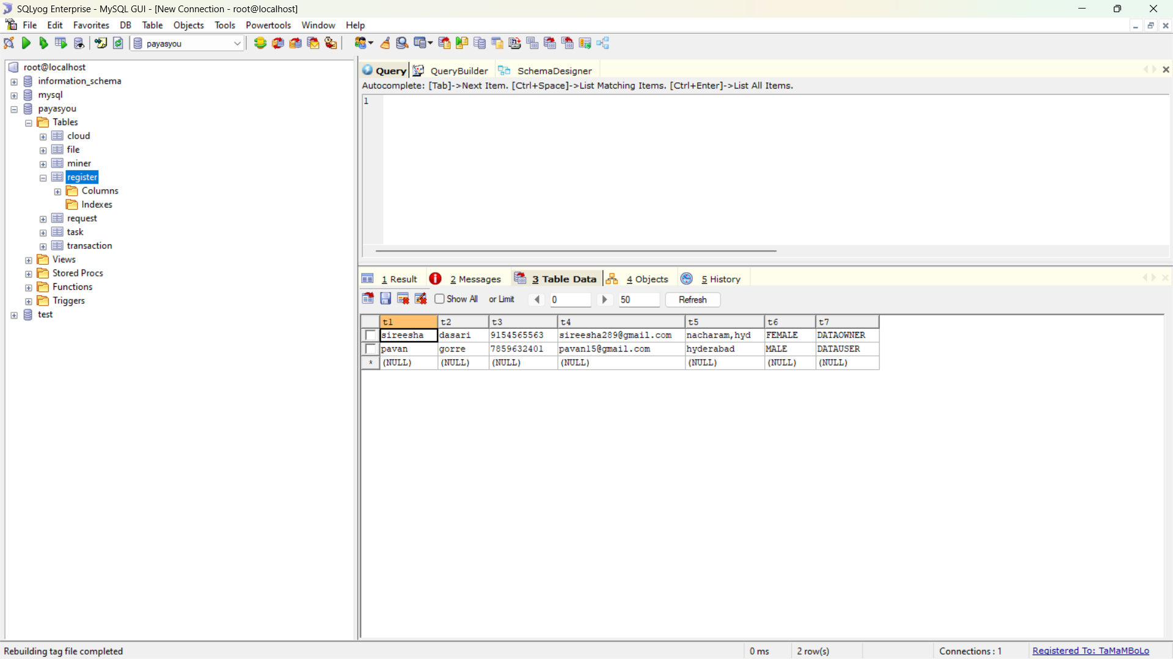
Experiment screenshots

Slide 11
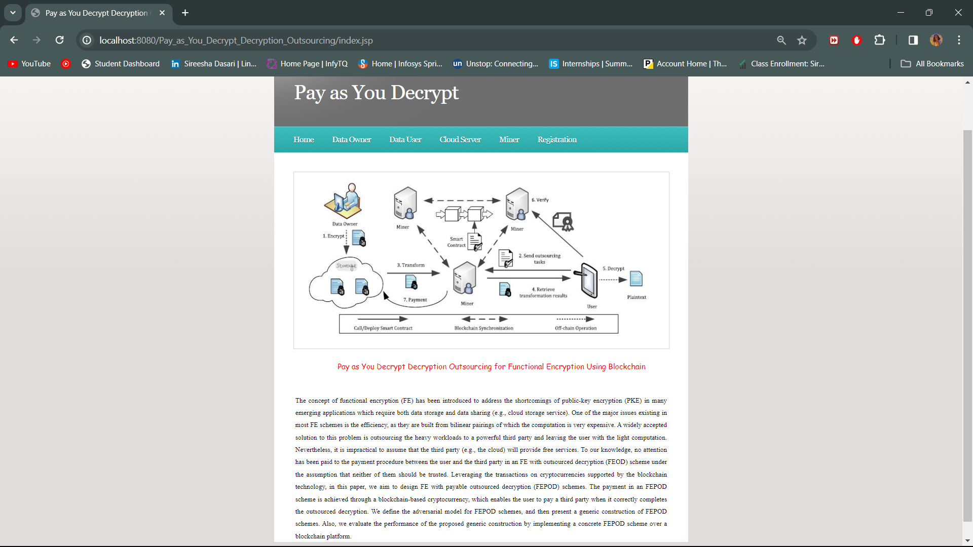
Experiment results

Slide 12
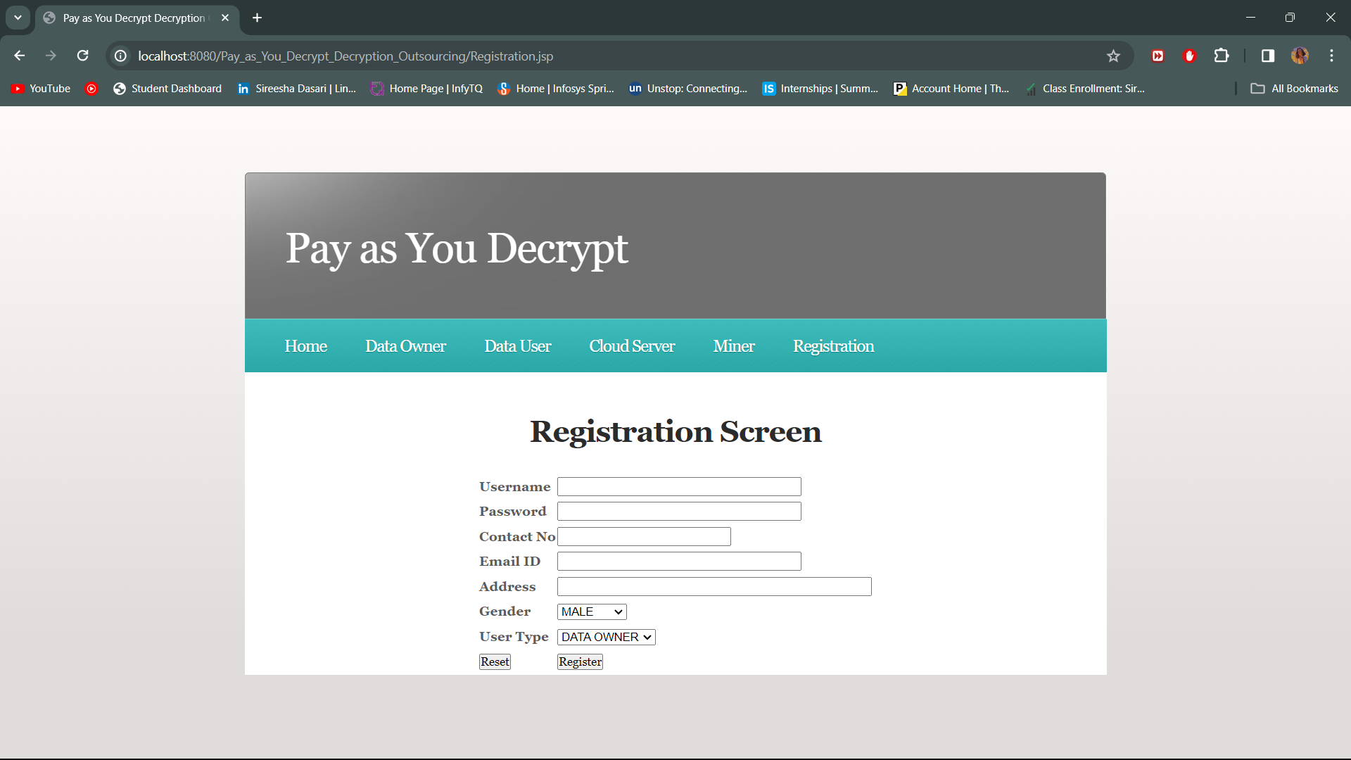
Experiment results

Slide 13
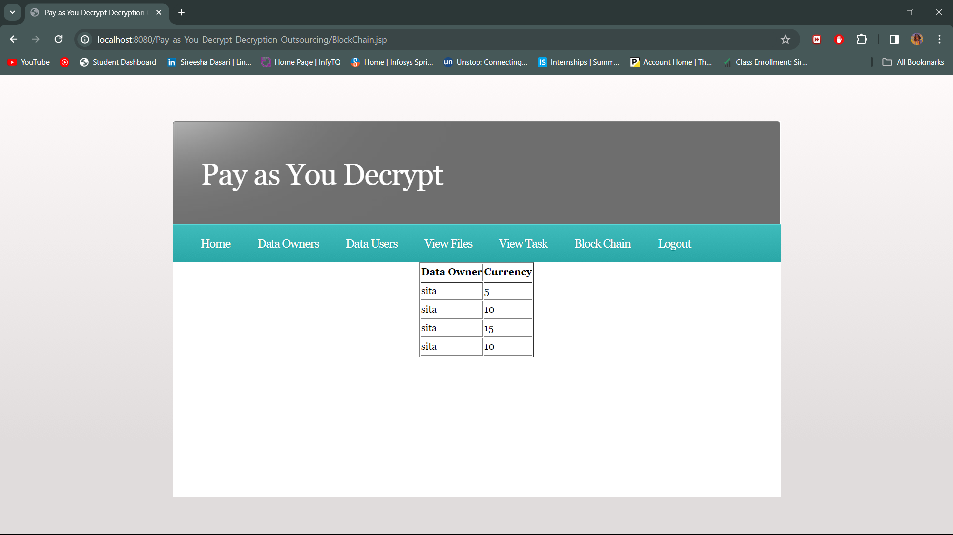
Experiment results

Slide 14
Justification
PARAMETERS:
Payment Process:
Payment Trigger
Payment Amount
Verification and Auditing:
Proof of Decryption
Transaction Transparency
Security Considerations:
Cryptography Standards
Secure Communication
Scalability:
Performance Metrics

Slide 15
Justification
Mathematical formula:
Payment calculation formulas may involve factors such as the size of the encrypted data, the complexity of the decryption process, and any additional service fees.
A simple formula for calculating payment could be
Payment = BaseFee + DataSize * RatePerByte + ServiceFee
Where:
BaseFee: Fixed fee for initiating a decryption request.
DataSize: Size of the encrypted data being decrypted.
RatePerByte: Fee rate charged per byte of decrypted data.
ServiceFee: Additional fee for using decryption services.

Slide 16
Thank you

